Slide 1

Functions
TUIT
C++ Programming, Fall 2016
Lecture #6
I - part

Slide 2
TUIT
Roadmap
Last week we covered
Loops
This week we will learn
Introduction
Defining a Function
Calling a Function
void Functions
Passing Arguments by Value
Modularizing Code
Overloading Functions
Function Prototypes
Default Arguments
Inline Functions
Local, Global, and Static Local Variables

Slide 3
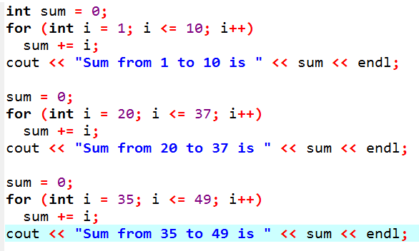
TUIT
Introduction
Functions can be used to define reusable code and organize and simplify code.
Suppose that you need to find the sum of integers from 1 to 10, from 20 to 37, and from 35 to 49, respectively. You may write the code as follows:

Slide 4
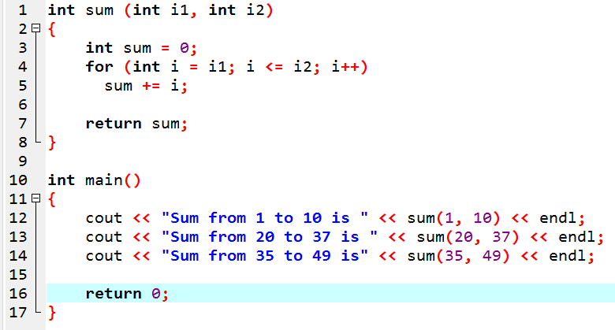
TUIT
Introduction
The preceding code can be simplified as follows:

Slide 5
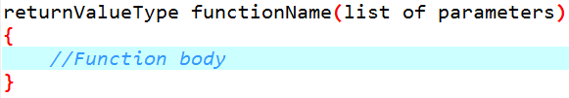
TUIT
Defining a Function
A function definition consists of its function name, parameters, return value type, and body.
The syntax for defining a function is as follows:

Slide 6
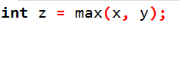
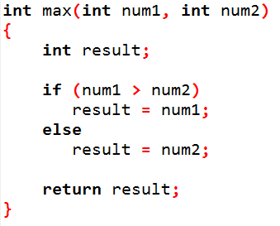
TUIT
Defining a Function
return value type
function name
formal parameters
actual parameters
(arguments)
parameter list
function
signature
function body
return value

Slide 7
TUIT
Caution
In the function header, you need to declare each parameter separately. For instance, max(int num1, int num2) is correct, but max(int num1, num2) is wrong.

Slide 8
TUIT
Calling a Function
Calling a function executes the code in the function.
If the function returns a value, a call to that function is usually treated as a value. For example,
int larger = max(3, 4);
calls max(3, 4) and assigns the result of the function to the variable. Another example of such a call is
cout << max(3, 4);
which prints the return value of the function call max(3, 4).

Slide 9
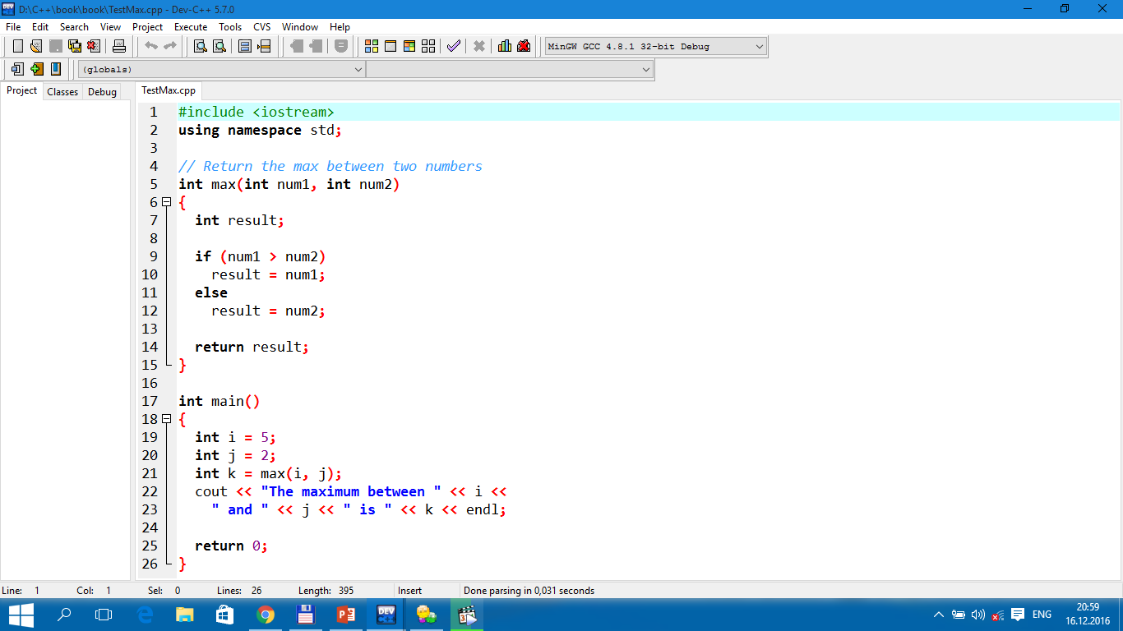

TUIT
Calling a Function
The maximum between 5 and 2 is 5

Slide 10
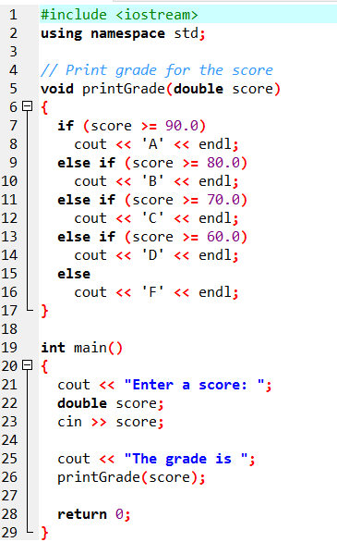

TUIT
void Functions
A void function does not return a value.
Enter a score: 78.5 The grade is C

Slide 11
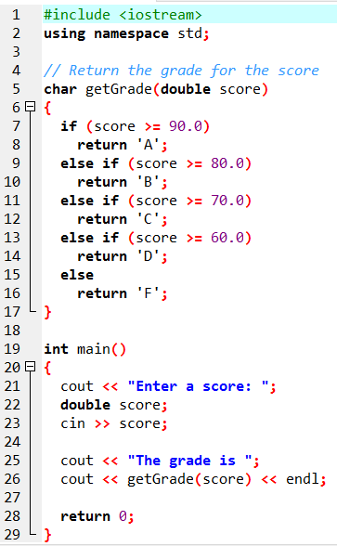
TUIT
void Functions
Translate Return Grade Function
Enter a score: 78.5 The grade is C

Slide 12
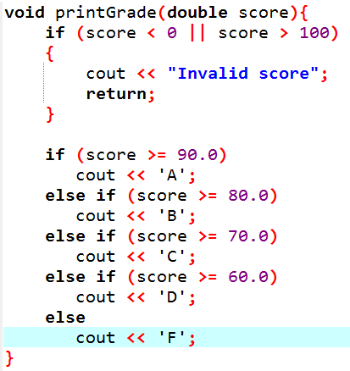
TUIT
Note
A return statement is not needed for a void function, but it can be used for terminating the function and returning control to the function’s caller. The syntax is simply
return;
This is rare but sometimes is useful for circumventing the normal flow of control in a void function. For example, the following code has a return statement to terminate the function when the score is invalid.

Slide 13
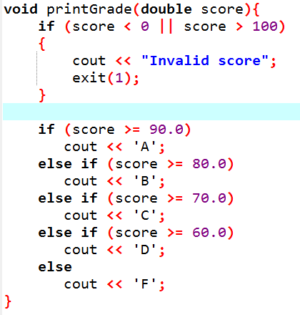
TUIT
Note
Occasionally you may need to terminate the program from the function immediately if an abnormal condition occurs. This can be done by invoking the exit(int) function defined in the cstdlib header. You can pass any integer to invoke this function to indicate an error in the program. For example, the following function terminates the program if an invalid score is passed to the function.

Slide 14
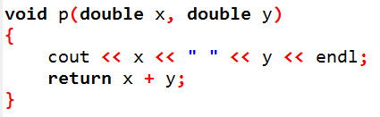
TUIT
Check Point
Does the return statement in the following function cause syntax errors?

Slide 15
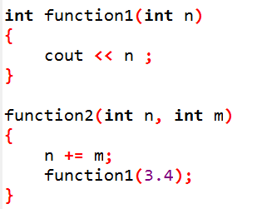
TUIT
Check Point
Identify and correct the errors in the following program:

Slide 16
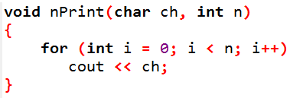
TUIT
Passing Arguments by Value
By default, the arguments are passed by value to parameters when invoking a function.
You can use nPrint(‘a’, 3) to print ‘a’ three times.

Slide 17
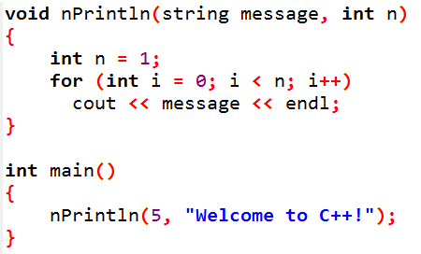
TUIT
Check Point
Identify and correct the errors in the following program:

Slide 18
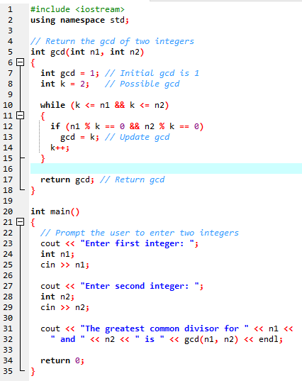
TUIT
Modularizing Code
Modularizing makes the code easy to maintain and debug and enables the code to be reused.
Enter first integer: 45 Enter second integer: 75 The greatest common divisor for 45 and 75 is 15

Slide 19
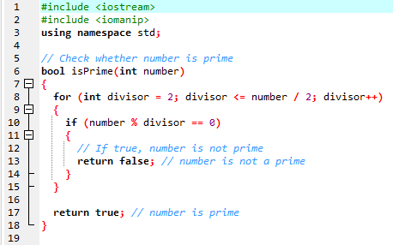
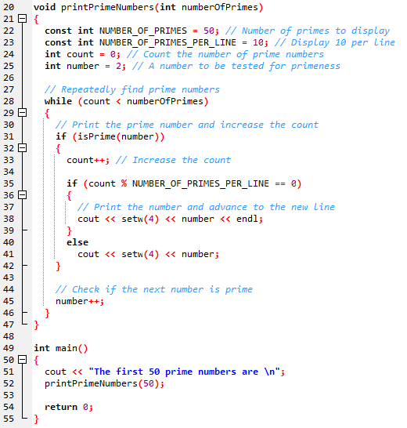
TUIT
Prime Number Function
The first 50 prime numbers are 2 3 5 7 11 13 17 19 23 29 31 37 41 43 47 53 59 61 67 71 73 79 83 89 97 101 103 107 109 113 127 131 137 139 149 151 157 163 167 173 179 181 191 193 197 199 211 223 227 229

Slide 20
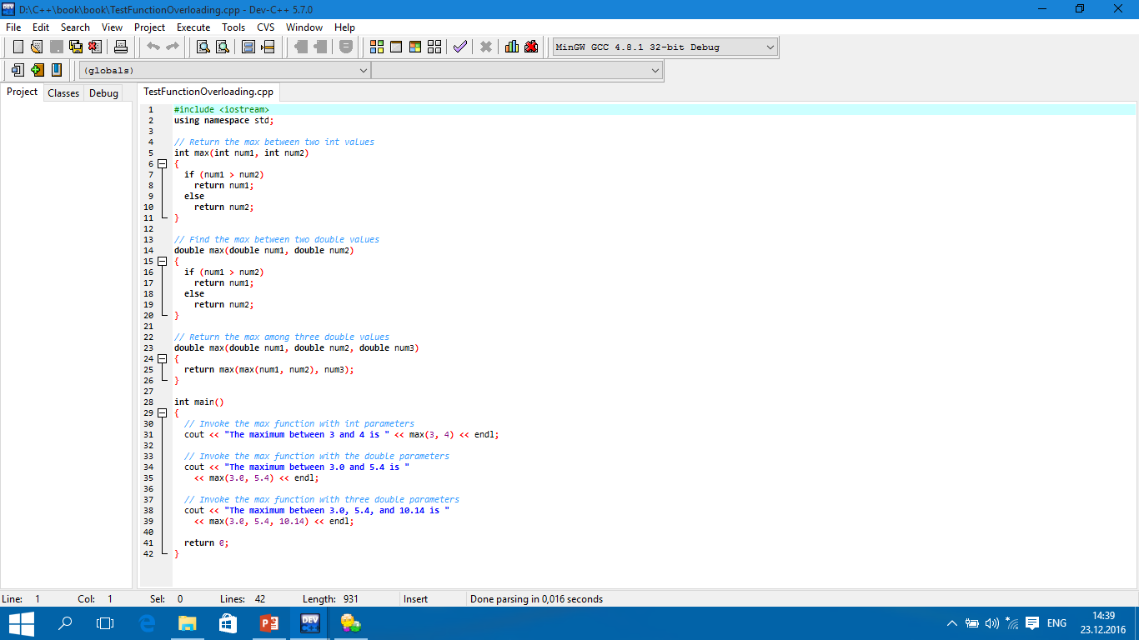
TUIT
Overloading Functions
Overloading functions enables you to define the functions with the same name as long as their signatures are different.
The maximum between 3 and 4 is 4 The maximum between 3.0 and 5.4 is 5.4 The maximum between 3.0, 5.4, and 10.14 is 10.14

Slide 21
TUIT
Tip
Overloading functions can make programs clearer and more readable. Functions that perform the same task with different types of parameters should be given the same name.

Slide 22
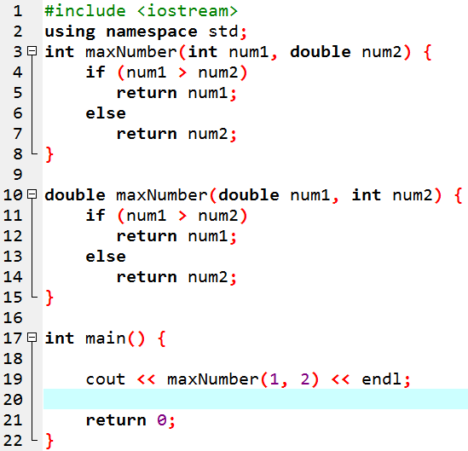
TUIT
Note
Overloaded functions must have different parameter lists. You cannot overload functions based on different return types.

Slide 23
TUIT
Caution
Math functions are overloaded in the <cmath> header file. For example, there are three overloaded functions for sin:
float sin(float)
double sin(double)
long double sin(long double)

Slide 24
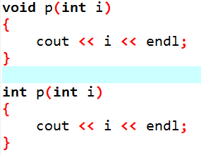
TUIT
Check Point
What is wrong in the following program?

Slide 25
TUIT
Check Point
Given two function definitions,
double m(double x, double y)
double m(int x, int y)
Answer the following questions:
double z = m(4, 5);
double z = m(4, 5.4);
double z = m(4.5, 5.4);

Slide 26
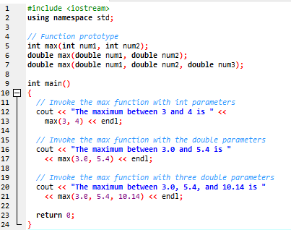
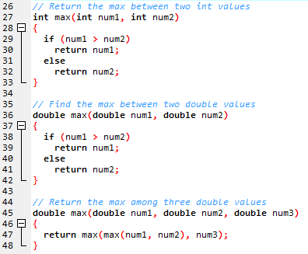
TUIT
Function Prototypes
A function prototype declares a function without having to implement it.

Slide 27
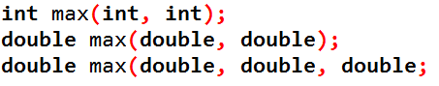
TUIT
Tip
In the prototype, you need not list the parameter names, only the parameter types. C++ compiler ignores the parameter names. The prototype tells the compiler the name of the function, its return type, the number of parameters, and each parameter’s type. So lines 5 – 7 can be replaced by

Slide 28
TUIT
Note
We say “define a function” and “declare a function”. Declaring a function specifies what a function is without implementing it. Defining a function gives a function body that implements the function.

Slide 29
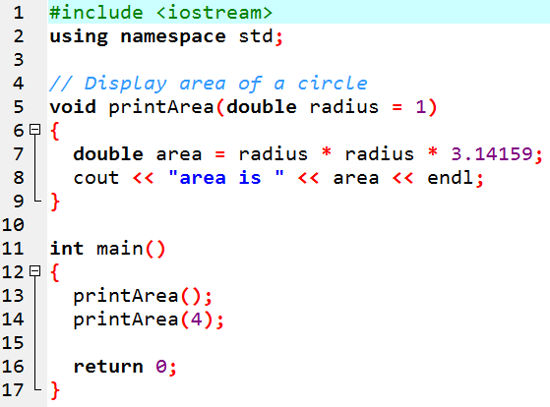
TUIT
Default Arguments
You can define default values for parameters in a function.
area is 3.14159 area is 50.2654

Slide 30
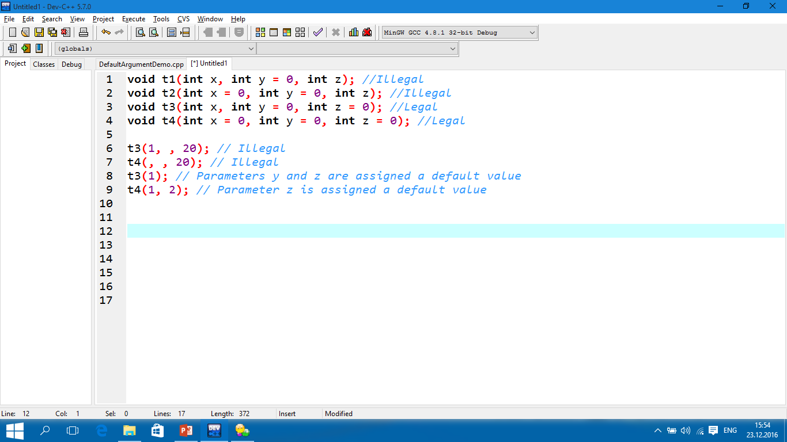
TUIT
Default Arguments
You can define default values for parameters in a function.

Slide 31
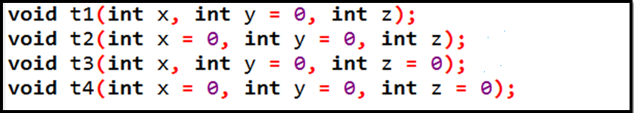
TUIT
Check Point
Which of the following function declarations are illegal?

Slide 32
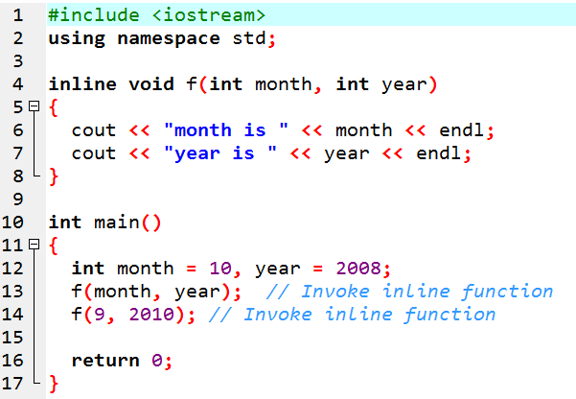
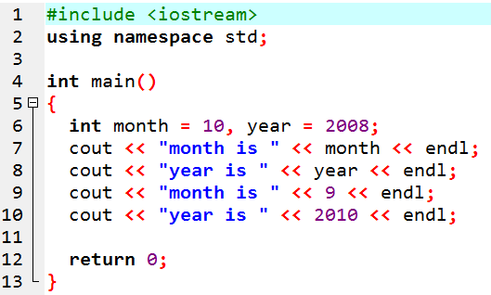
TUIT
Inline Functions
C++ provides inline functions for improving performance for short functions.
Inline function expanded
month is 10 year is 2008 month is 9 year is 2010

Slide 33
TUIT
Local, Global, and Static Local Variables
A variable can be declared as a local, a global, or a static local in C++. A variable defined inside a function is referred to as a local variable. C++ also allows you to use global variables. They are declared outside all functions and are accessible to all functions in their scope. Local variables do not have default values, but global variables are defaulted to zero. A variable must be declared before it can be used. The scope of a local variable starts from its declaration and continues to the end of the block that contains the variable. The scope of a global variable starts from its declaration and continues to the end of the program.

Slide 34
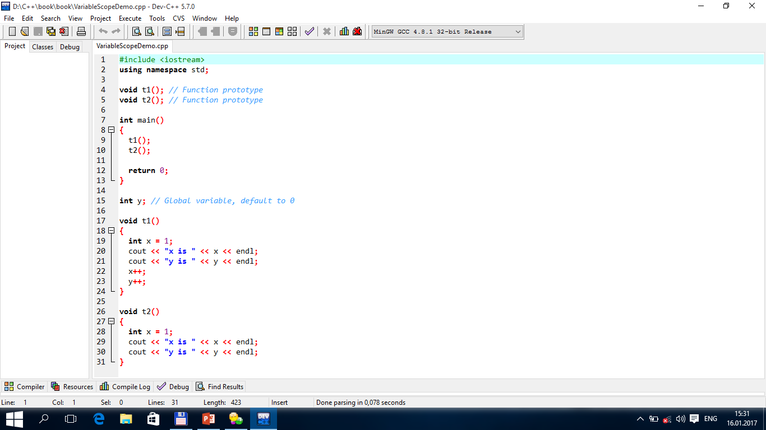
TUIT
Local, Global, and Static Local Variables
x is 1 y is 0 x is 1 y is 1

Slide 35
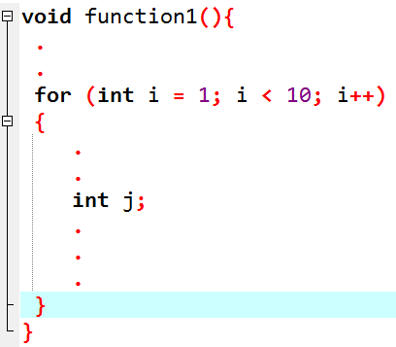
TUIT
The Scope of Variables in a for Loop
A variable declared in the initial-action part of a for-loop header has its scope in the entire loop.
The scope of i
The scope of j

Slide 36
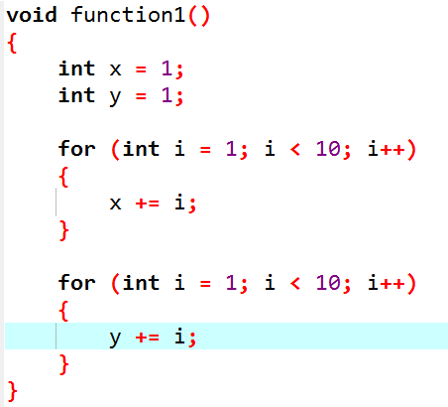
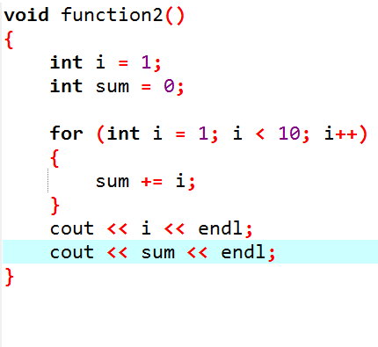
TUIT
The Scope of Variables in a for Loop
It is fine declare i in two nonnesting blocks
It is not a good practice to declare i in two nesting blocks

Slide 37
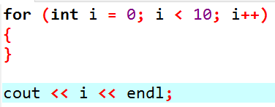
TUIT
Caution
Do not declare a variable inside a block and then attempt to use it outside the block. Here is an example of a common mistake:

Slide 38
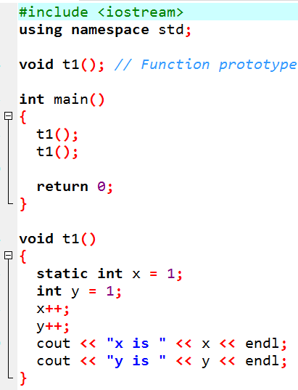
TUIT
Static Local Variables
After a function completes its execution, all its local variables are destroyed. Static local variables are permanently allocated in the memory for the life time of the program. To declare a static variable, use the keyword static.
x is 2 y is 2 x is 3 y is 2

Slide 39
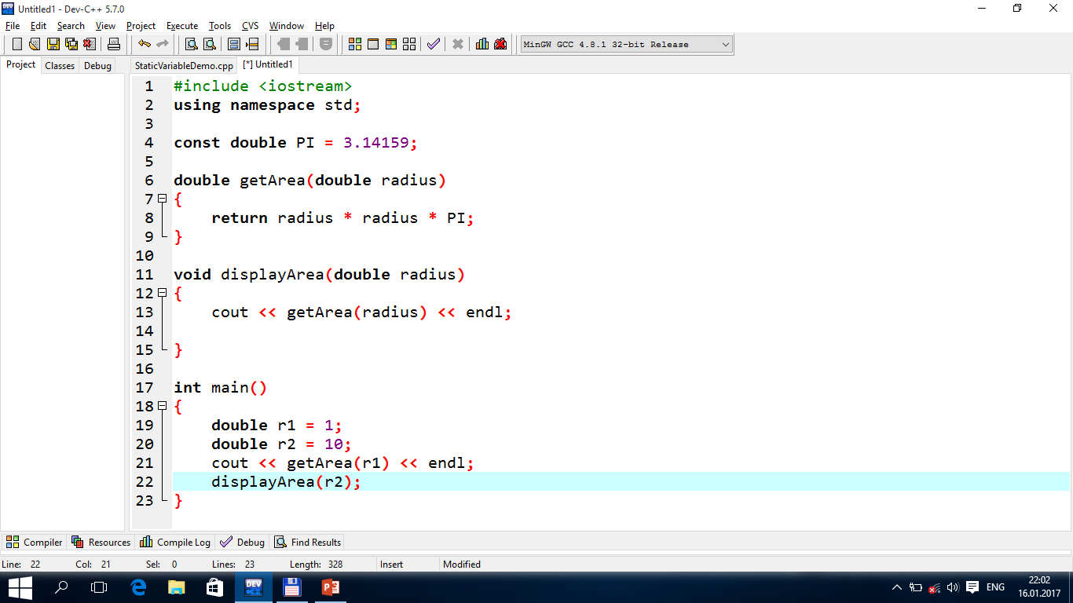
TUIT
Check Point
Show the output of the following code:

Slide 40
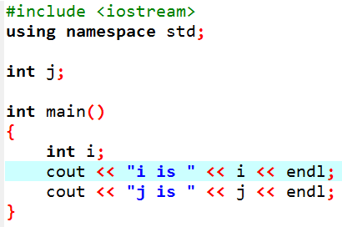
TUIT
Check Point
Identify global and local variables in the following program:

Slide 41
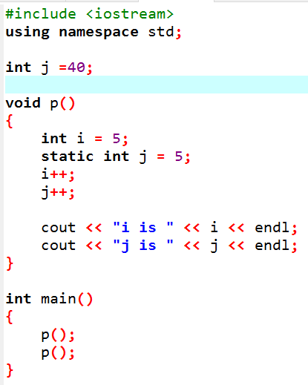
TUIT
Check Point
Identify global variables, local variables, and static local variables in the following program. What will be the output of the code?

Slide 42
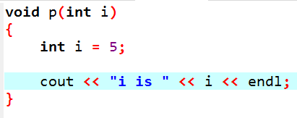
TUIT
Check Point
Identify and correct the errors in the following program:

Slide 43
TUIT
Summary
Making programs modular and reusable is a goal of software engineering. Function can be used to develop modular and reusable code.
The function header specifies the return value type, function name, and parameters of the function.
A function may return a value. The returnValueType is the data type of the value that the function returns.
If the function does not return a value, the returnValueType is the keyword void.
The parameter list refers to the type, order, and number of the parameters of a function .
The arguments that are passed to a function should have the same number, type, and order as the parameters in the function signature.
The function name and the parameter list together constitute the function signature.
Parameters are optional; that is, a function may contain no parameters.
A value-returning function must return a value when the function is finished.
A return statement can be used in a void function for terminating the function and returning control to the function’s caller.
When a program calls a function, program control is transferred to the called function.

